Slide 1


JAVA INTERVIEW BOOTCAMP CORE CONCEPTS
Lecture 17
Strings

Slide 2
CHAPTER 17
Strings
Topics Covered
The String class
The StringBuffer class
The StringBuilder class

Slide 3
What Is A String ?
In Java, a string is defined as a sequence of characters.
But, unlike many other languages that implement strings as character arrays, java implements strings as objects of type String.

Slide 4
How To Represent Strings In Java ?
Java handles Strings by three classes:
String
StringBuffer and
StringBuilder
All are defined in the package java.lang and and most interviews cover only String and StringBuffer classes

Slide 5
String V/s StringBuffer V/s StringBuilder
String | StringBuffer | StringBuilder
Added from JDK 1.0 | Added from JDK 1.0 | Added from JDK 5.0
String objects are immutable | StringBuffer objects are mutable | StringBuilder objects are mutable
String objects are stored in heap and string constants are stored in “String Pool” | StringBuffer objects are stored in heap | StringBuilder objects are stored in heap
Thread-Safe | Thread-Safe | Not Thread-Safe
Fast performance | Very slow performance | Fast performance

Slide 6
Important Facts About “String”
String is probably the most commonly used class in java library.
String class is encapsulated under java.lang package.
In java, every string that you create is actually an object of type String.
One important thing to notice about string object is that they are immutable

Slide 7
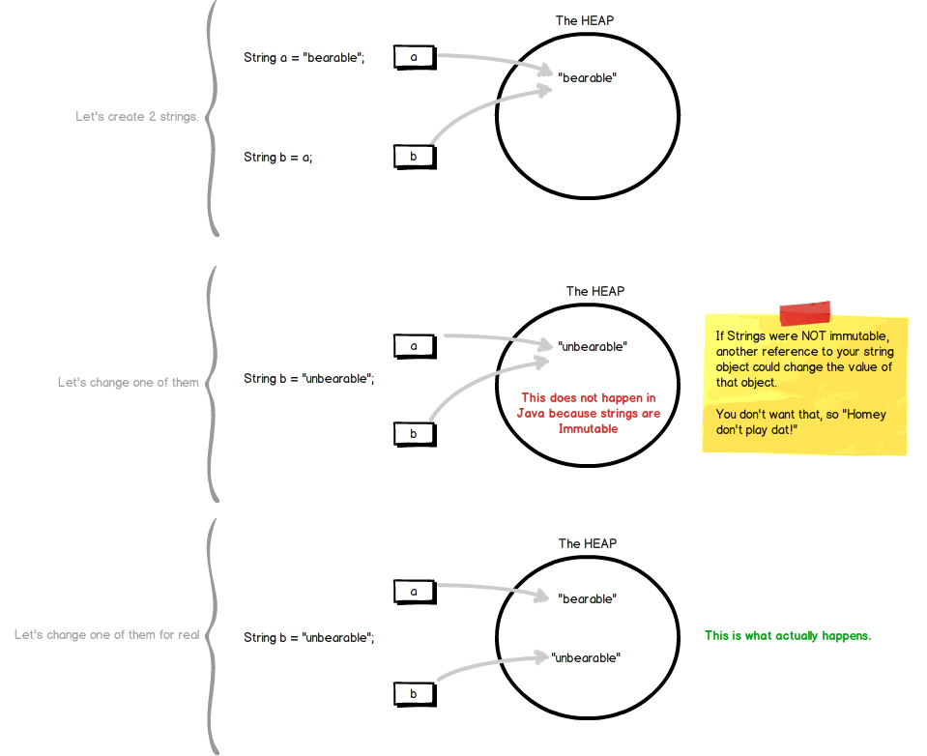
What Is An Immutable Object ?

Slide 8
Creating “String” Object
Java provides 2 ways to create “String” objects
Using “String Literal”
Using new keyword

Slide 9
String Literals…
are anonymous objects of the String class
are defined by enclosing text in double quotes. “Bhopal”
can be passed to methods and constructors as parameters.
have methods we can call.

Slide 10
String Literal Examples
//assign a literal to a String variable
String name = “Sachin”;
//calling a method on a literal String
int len = “Sachin”.length( );

Slide 11
Using The new Keyword
Using the new operator creates a memory location on the heap.
Example:
String name=new String(“Sachin”);
name
“Sachin”

Slide 12
What Is The Difference ?
String literals reside in a special area of memory called “String Constant Pool” while string objects live in heap.
When the compiler encounters a String literal, it checks the pool to see if an identical String already exists.
If a match is found, the reference to the new literal is directed to the existing String, and no new String literal object is created. (The existing String simply has an additional reference.)

Slide 13
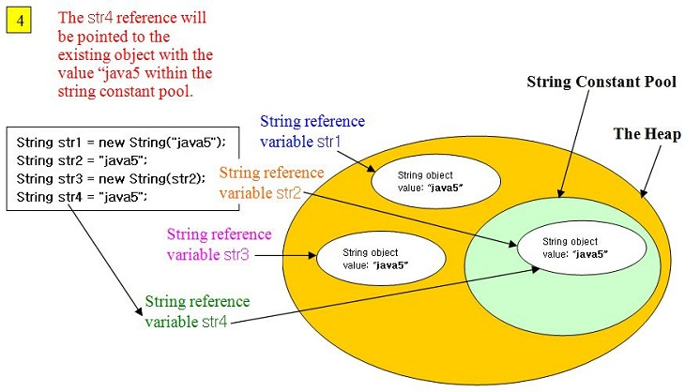
What Is The Difference ?

Slide 14
Empty Strings
An empty String has no characters. It’s length is 0.
Not the same as an uninitialized String.
String word1 = "";
String word2 = new String();
Empty strings
private String name;
name is null

Slide 15
No Argument Constructors
No-argument constructor creates an empty String.
A more common approach is to assign the variable to an empty literal String.
String empty = new String();
String empty = “”;//nothing between quotes

Slide 16
Copy Constructors
Copy constructor creates a copy of an existing String.
Not the same as an assignment.
Copy Constructor: Each variable points to a different copy of the String.
String word = new String(“Java”); String word2 = new String(word);
word
“Java"
word2
“Java"
Assignment: Both variables point to the same String.
String word = “Java”; String word2 = word;
word
“Java"
word2
String word3= “Java”;
word3

Slide 17
Other Constructors
Most other constructors take an array as a parameter
to create a String.
char[] letters = {‘J’, ‘a’, ‘v’, ‘a’}; String word = new String(letters);//”Java”

Slide 18
Methods — length, charAt
int length();
char charAt(int i);
Returns the number of characters in the string
Returns the char at position i.
Character positions in strings are numbered starting from 0 – just like arrays.
Returns:
”Problem”.length();
”Window”.charAt (2);
7
’n'

Slide 19
What Is The Output ?
String x=“test”;
System.out.println(x.length);
String [ ] months=new String[12];
System.out.println(months.length());
Both codes will produce syntax error!

Slide 20
Why ?
Arrays have an attribute (not a method) called length, while String objects have a method called length() ( not an attribute)
So an attempt to use the length() method on an array or an attempt to use the length attribute on a String, both cause compiler error

Slide 21
Methods — substring
Returns a new String by copying characters from an existing String.
String subs = word.substring (i, k);
returns the substring of chars in positions from i to k-1
String subs = word.substring (i);
returns the substring from the i-th char to the end
television
i k
television
i
Returns:
”television”.substring (2,5);
“immutable”.substring (2);
“hello”.substring (5);
“lev”
“mutable”
"" (empty string)

